Slide 1
Game AI
Introduction to Game Design and Development
ITCS 4230/5230
Dr. Dewan Tanvir Ahmed
Department of Computer Science
University of North Carolina at Charlotte

Slide 2
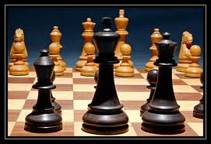
AI Software
Basic Algorithms
AI Programming Concept
Game Search
Minimax
Alpha-beta Pruning

Slide 3
Objectives
Learn the basic concepts in game and computer science AI
Review the common types of game AI
Understand common models and software methods for game AI
AI programming concepts
Game search
Evaluation function
Minimax search (turn based games)
Alpha-beta pruning

Slide 4
What is Artificial Intelligence?
The aim of AI is to develop machines that behave as if they were intelligent.
In short – Computers making decisions in real-world problems
John McCarthy, Stanford University
Notes:
Use computers to understand human intelligence

Slide 5
What is Artificial Intelligence?
Video: Coke Robot
One More: Robot Quad rotors
What’s involved in Intelligence?
Perceiving, recognizing, understanding the real world
Reasoning and planning about the external world
Learning and adaptation
Notes:
You might consider this little robot intelligent. Some of you could say it is intelligent, other may say it is not intelligent.
At least, it was able to solve the task. It can remove all coca-cola from this area marked by black stripes and keep all pepsi.
Now let me tell you how this robot works.
This robot at the front has a little touch sensor. It also has a sensor at the bottom that tells whether it moves across the black boundary. And its everything.
Random movement. ….
Its extremely simple. Its extremely simple logic. Would you now still consider this robot intelligent.
The simple message is not everything that looks as if it were intelligent is really intelligent.
So we need may be somewhat deeper understanding of intelligence, may be that’s what we need. But may we will not be able to define this term intelligent precisely enough.

Slide 6

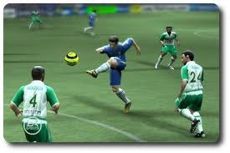
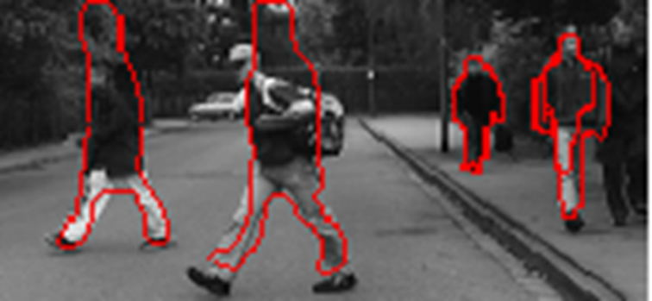
AI Applications
Robotics
Natural Language Processing
Knowledge representation and reasoning
Computer Games

Slide 7
What is AI?
Artificial Intelligence
In Computer Science (CS)
Actually solving problems that need intelligence by a computer
In Games
Autonomous agents
Behaviours that appear intelligent
Anything behind the scene
Not exactly the same as CS AI

Slide 8
CS AI
Automaton
Self-controlled devices as late as 1st century AD
Checkers-playing machine by Arthur Samuel, 1949
Using heuristic search
Turing Test by Alan Turing, 1950
ELIZA by Loseph Wiezenbaum, 1964
Logic Theorist by Shaw and Simon, 1956
Discover proof for geometric theorems
Artificial Neural Networks, McCulloch and Pitts, 1943, and others later
Fuzzy Logic by Lotfi Zadeh, 1965
Knowledge-based and expert systems, 1960s

Slide 9
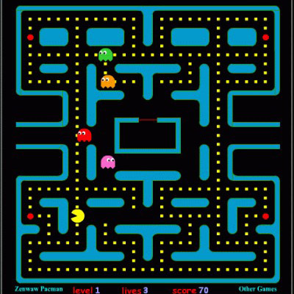
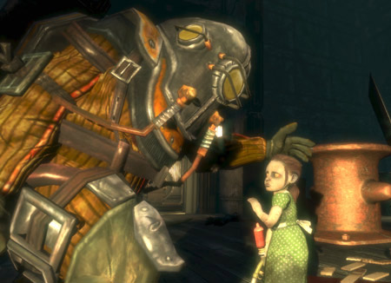
Game AI
Characters
Non-Player Characters
Pacman’s Ghosts to BioShock’s Little Sisters

Slide 10
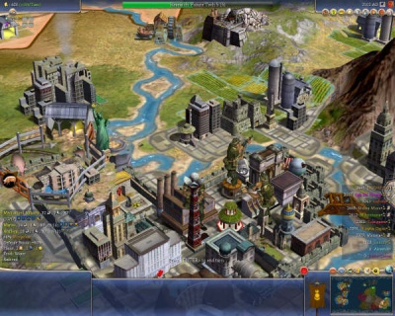
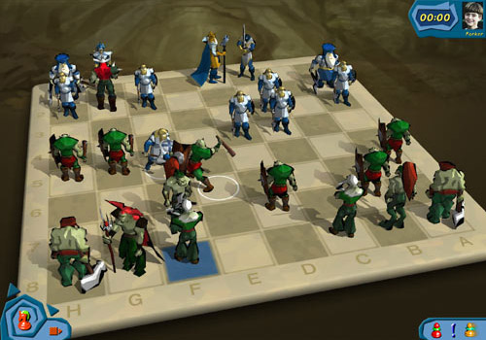
Game AI
Virtual players
Agents that are not visible (e.g Civilization)
Impacts through decisions

Slide 11
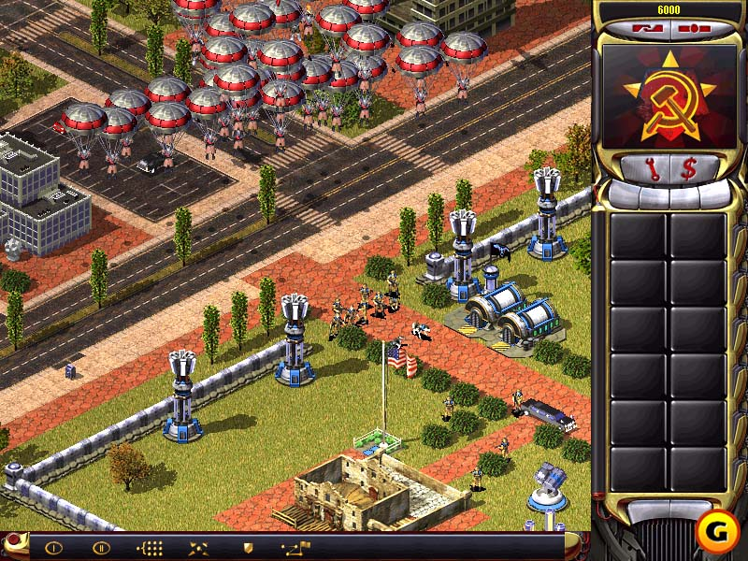
Game AI
Using multiple agent types
In Half-life, for example, there is no sense of “opposing player”, but in some games we have that plus AI NPCs.
Red Alert 2

Slide 12
Intelligent Agents
React to the environment
Solve problems such as path finding
Choose appropriate responses
Exhibit more than one behaviour
Anticipate the future
Exhibit a level of skill
Customize behaviours
Personality, mood, energy, age, etc.

Slide 13
AI Programming Concepts
Algorithm
A well-defined set of steps to produce the desired results
An algorithm does the intended task at a bounded cost
time and memory (space)
Search and sort algorithms are very common in AI
Linear Search
Binary search
Insertion sort, Selection sort, Bubble sort
Quick Sort, Merge sort

Slide 14
Linear Search Algorithm
For each item in the list:
Check to see if the item you're looking for matches the item in the list.
If it matches:
Return the location where you found it (the index).
If it does not match:
Continue searching until you reach the end of the list.
If we get here, we know the item does not exist in the list. Return -1.

Slide 15
Linear search
i := 1
while ( i ≤ n and x ≠ a_{i} )
i := i + 1
if i ≤ n then location := i
else location := -1
procedure linear_search (x: integer; a₁, a₂, …, a_{n}: integers)
i := 1
while ( i ≤ n and x ≠ a_{i} )
i := i + 1
if i ≤ n then location := i
else location := -1
x
3
location
8
a₁ | a₂ | a₃ | a₄ | a₅ | a₆ | a₇ | a₈ | a₉ | a₁₀
4 | 1 | 7 | 0 | 5 | 2 | 9 | 3 | 6 | 8
i
2
3
4
5
6
7
8
1

Slide 16
Binary Search
//For sorted lists
BinarySearch(A[0..N-1], value)
{
low = 0; high = N – 1;
while (low <= high) {
mid = (low + high) / 2;
if (A[mid] > value)
high = mid - 1
else if (A[mid] < value)
low = mid + 1
else
return mid // found
}
return -1 // not found
}

Slide 17
Algorithm 3: Binary search, take 1
procedure binary_search (x: integer; a₁, a₂, …, a_{n}: increasing integers)
while i < j
begin
m := ⎣(i+j)/2⎦
if x > a_{m} then i := m+1
else j := m
end
i := 1
j := n
while i < j
begin
m := ⎣(i+j)/2⎦
if x > a_{m} then i := m+1
else j := m
end
i := 1
j := n
if x = a_{i} then location := i
else location := -1
if x = a_{i} then location := i
x
14
location
7
a₁ | a₂ | a₃ | a₄ | a₅ | a₆ | a₇ | a₈ | a₉ | a₁₀
2 | 4 | 6 | 8 | 10 | 12 | 14 | 16 | 18 | 20
i
1
6
7
m
5
8
7
6
j
10
8
7

Slide 18
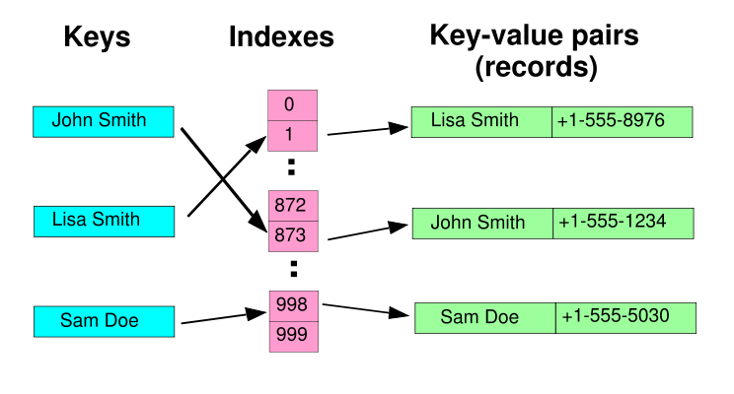
Hash Table
Key -> hash -> value
Hash function converts “key” to an index to be used to get the “value”

Slide 19
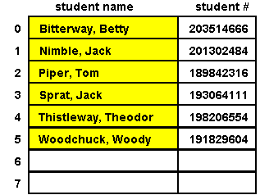
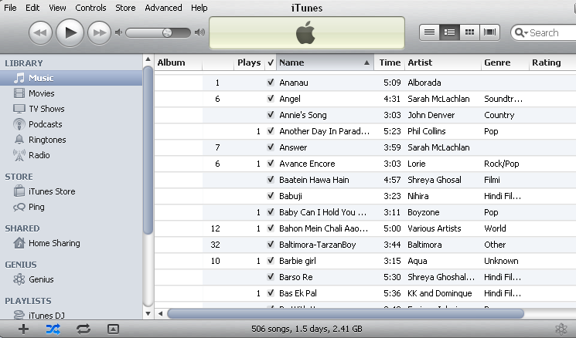

Sorting
What is sorting?
It means organization/arrange items in some specified order
Applications
Sort a list of names
Organize an MP3 library
Display Google Page Rank results

Slide 20
Types of Sorting Algorithm
There are many, many different types of sorting algorithms, but the primary ones are:
Bubble Sort
Selection Sort
Insertion Sort
Merge Sort
Quick Sort
The sorting complexity is defined by
Time
Space
Study
Bubble sort
Selection sort
Merge sort
Quick sort

Slide 21
Bubble Sort
Compare pairs of list items and swap if necessary. Continue as long as needed.
BubbleSort( A : list )
do
swapped := false
for each i in 0 to length( A ) - 1
if A[ i ] > A[ i + 1 ]
swap( A[ i ], A[ i + 1 ] )
swapped := true
while swapped
Example: Youtube
do
swapped := false
for each i in 0 to length( A ) - 1
if A[ i ] > A[ i + 1 ]
swap( A[ i ], A[ i + 1 ] )
swapped := true
while swapped

Slide 22
Selection Sort
The simplest sorting techniques
a good algorithm to sort a small number of elements
Working principle
find the smallest in the array and exchange it with the element in the first position
find the second smallest in the array and exchange it with the element in the second position
unsorted
smallest
sorted
60
27
27
27
27
42
42
42
42
42
42
75
75
75
60
60
83
83
83
83
75
27
60
60
27
60
75
83
75

Slide 23

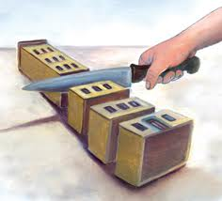
Divide-and-Conquer
Divide and Conquer is a most widely used method of algorithm
Three properties
Divide a problem into smaller sub problems - DIVIDE
If the input size is too large to deal with in a straightforward manner
Divide the data into two or more disjoint subsets
Solve the sub problems – RECUR
Use divide and conquer to solve the sub-problems associated with the data subsets
Combine the solutions – CONQUER
Take the solutions to the sub-problems and “merge” these solutions into a solution for the original problem

Slide 24
Understanding of Merging
Merge()
Merge takes two sorted lists and merges them into a single sorted list
3
27
38
43
9
25
30
82
Compare
Compare
3
9
25
27
30
38
43
82
Notes:
Central feature of the merge sort is the merging step.
The merging step takes two sorted sequences and merges them into one sorted sequence.
Here we have two sorted arrays.
To merge them we continually take the next smallest element and put them into a new array.
For illustration, …
We start by comparing the smallest element of each array.
Since 3 is smaller than 9, we put them into the bottom and move to next element of the same array.

Slide 25
Merge Sort - Description
Divide
If S has at least two elements remove all the elements from S and put them into two sequences, S1 and S2, each containing about half of the elements of S
S
S1
S2
Recur
Recursive sort sequences S1 and S2
S1
S2
S11
S12
S21
S22
Conquer
Put back the elements into S by merging the sorted sequences S1 and S2 into a unique sorted sequence
S
S1
S2

Slide 26
Concept of merge sort
Suppose we have an unsorted array like this one.
We can think of this array as eight little sorted arrays each with one element in it.
Then we can merge each pair into a large array using the merging step.
38
27
43
3
9
82
30
25
38
27
43
3
9
82
30
25
27
38
3
43
9
82
25
30
Notes:
Suppose we have an unsorted array like this one.
We can think of this array as eight little sorted arrays each with one element in it.
Then we can merge each pair into a large array using the merging step.
We start with elements 38 and 27 and merge them into an two element array.
Then we merge 43 and 3 into a second array.
Then 9 and 82.
And Finally 30 and 25.
Now all are elements are sorted in two-element arrays.
Then we move onto sort two-element arrays to four-element arrays.
lastly, we merge four-element arrays to a single eight-element array to finish the sort.

Slide 27
Merge Sort - Example
38
27
43
3
9
82
30
25
38
27
43
3
9
82
30
25
38
27
43
3
9
82
30
25
38
27
43
3
9
82
30
25
27
38
3
43
9
82
25
30
3
27
38
43
9
25
30
82
3
9
25
27
30
38
43
82

Slide 28
Quicksort Algorithm
Given an array of n elements (e.g., integers):
if array only contains one element, return
else
pick one element to use as pivot.
Partition elements into two sub-arrays:
Elements less than or equal to pivot
Elements greater than pivot
Quicksort two sub-arrays
Return results

Slide 29
Example
We are given array of n integers to sort:
40
20
10
80
60
50
7
30
100

Slide 30
Pick Pivot Element
There are a number of ways to pick the pivot element. In this example, we will use the first element in the array:
40
20
10
80
60
50
7
30
100

Slide 31
Partitioning Array
Given a pivot, partition the elements of the array such that the resulting array consists of:
One sub-array that contains elements >= pivot
Another sub-array that contains elements < pivot
The sub-arrays are stored in the original data array.
Partitioning loops through, swapping elements below/above pivot.

Slide 32
pivot_index = 0
40
20
10
80
60
50
7
30
100
[0] [1] [2] [3] [4] [5] [6] [7] [8]
too_big_index
too_small_index

Slide 33
While data[too_big_index] <= data[pivot]
++too_big_index
pivot_index = 0
40
20
10
80
60
50
7
30
100
[0] [1] [2] [3] [4] [5] [6] [7] [8]
too_big_index
too_small_index

Slide 34
While data[too_big_index] <= data[pivot]
++too_big_index
pivot_index = 0
40
20
10
80
60
50
7
30
100
[0] [1] [2] [3] [4] [5] [6] [7] [8]
too_big_index
too_small_index

Slide 35
While data[too_big_index] <= data[pivot]
++too_big_index
pivot_index = 0
40
20
10
80
60
50
7
30
100
[0] [1] [2] [3] [4] [5] [6] [7] [8]
too_big_index
too_small_index

Slide 36
While data[too_big_index] <= data[pivot]
++too_big_index
While data[too_small_index] > data[pivot]
--too_small_index
pivot_index = 0
40
20
10
80
60
50
7
30
100
[0] [1] [2] [3] [4] [5] [6] [7] [8]
too_big_index
too_small_index

Slide 37
While data[too_big_index] <= data[pivot]
++too_big_index
While data[too_small_index] > data[pivot]
--too_small_index
pivot_index = 0
40
20
10
80
60
50
7
30
100
[0] [1] [2] [3] [4] [5] [6] [7] [8]
too_big_index
too_small_index

Slide 38
While data[too_big_index] <= data[pivot]
++too_big_index
While data[too_small_index] > data[pivot]
--too_small_index
If too_big_index < too_small_index
swap data[too_big_index] and data[too_small_index]
pivot_index = 0
40
20
10
80
60
50
7
30
100
[0] [1] [2] [3] [4] [5] [6] [7] [8]
too_big_index
too_small_index

Slide 39
While data[too_big_index] <= data[pivot]
++too_big_index
While data[too_small_index] > data[pivot]
--too_small_index
If too_big_index < too_small_index
swap data[too_big_index] and data[too_small_index]
pivot_index = 0
40
20
10
30
60
50
7
80
100
[0] [1] [2] [3] [4] [5] [6] [7] [8]
too_big_index
too_small_index

Slide 40
While data[too_big_index] <= data[pivot]
++too_big_index
While data[too_small_index] > data[pivot]
--too_small_index
If too_big_index < too_small_index
swap data[too_big_index] and data[too_small_index]
While too_small_index > too_big_index, go to 1.
pivot_index = 0
40
20
10
30
60
50
7
80
100
[0] [1] [2] [3] [4] [5] [6] [7] [8]
too_big_index
too_small_index

Slide 41
While data[too_big_index] <= data[pivot]
++too_big_index
While data[too_small_index] > data[pivot]
--too_small_index
If too_big_index < too_small_index
swap data[too_big_index] and data[too_small_index]
While too_small_index > too_big_index, go to 1.
pivot_index = 0
40
20
10
30
60
50
7
80
100
[0] [1] [2] [3] [4] [5] [6] [7] [8]
too_big_index
too_small_index

Slide 42
While data[too_big_index] <= data[pivot]
++too_big_index
While data[too_small_index] > data[pivot]
--too_small_index
If too_big_index < too_small_index
swap data[too_big_index] and data[too_small_index]
While too_small_index > too_big_index, go to 1.
pivot_index = 0
40
20
10
30
60
50
7
80
100
[0] [1] [2] [3] [4] [5] [6] [7] [8]
too_big_index
too_small_index

Slide 43
While data[too_big_index] <= data[pivot]
++too_big_index
While data[too_small_index] > data[pivot]
--too_small_index
If too_big_index < too_small_index
swap data[too_big_index] and data[too_small_index]
While too_small_index > too_big_index, go to 1.
pivot_index = 0
40
20
10
30
60
50
7
80
100
[0] [1] [2] [3] [4] [5] [6] [7] [8]
too_big_index
too_small_index

Slide 44
While data[too_big_index] <= data[pivot]
++too_big_index
While data[too_small_index] > data[pivot]
--too_small_index
If too_big_index < too_small_index
swap data[too_big_index] and data[too_small_index]
While too_small_index > too_big_index, go to 1.
pivot_index = 0
40
20
10
30
60
50
7
80
100
[0] [1] [2] [3] [4] [5] [6] [7] [8]
too_big_index
too_small_index

Slide 45
While data[too_big_index] <= data[pivot]
++too_big_index
While data[too_small_index] > data[pivot]
--too_small_index
If too_big_index < too_small_index
swap data[too_big_index] and data[too_small_index]
While too_small_index > too_big_index, go to 1.
pivot_index = 0
40
20
10
30
60
50
7
80
100
[0] [1] [2] [3] [4] [5] [6] [7] [8]
too_big_index
too_small_index

Slide 46
While data[too_big_index] <= data[pivot]
++too_big_index
While data[too_small_index] > data[pivot]
--too_small_index
If too_big_index < too_small_index
swap data[too_big_index] and data[too_small_index]
While too_small_index > too_big_index, go to 1.
pivot_index = 0
40
20
10
30
7
50
60
80
100
[0] [1] [2] [3] [4] [5] [6] [7] [8]
too_big_index
too_small_index

Slide 47
While data[too_big_index] <= data[pivot]
++too_big_index
While data[too_small_index] > data[pivot]
--too_small_index
If too_big_index < too_small_index
swap data[too_big_index] and data[too_small_index]
While too_small_index > too_big_index, go to 1.
pivot_index = 0
40
20
10
30
7
50
60
80
100
[0] [1] [2] [3] [4] [5] [6] [7] [8]
too_big_index
too_small_index

Slide 48
While data[too_big_index] <= data[pivot]
++too_big_index
While data[too_small_index] > data[pivot]
--too_small_index
If too_big_index < too_small_index
swap data[too_big_index] and data[too_small_index]
While too_small_index > too_big_index, go to 1.
pivot_index = 0
40
20
10
30
7
50
60
80
100
[0] [1] [2] [3] [4] [5] [6] [7] [8]
too_big_index
too_small_index

Slide 49
While data[too_big_index] <= data[pivot]
++too_big_index
While data[too_small_index] > data[pivot]
--too_small_index
If too_big_index < too_small_index
swap data[too_big_index] and data[too_small_index]
While too_small_index > too_big_index, go to 1.
pivot_index = 0
40
20
10
30
7
50
60
80
100
[0] [1] [2] [3] [4] [5] [6] [7] [8]
too_big_index
too_small_index

Slide 50
While data[too_big_index] <= data[pivot]
++too_big_index
While data[too_small_index] > data[pivot]
--too_small_index
If too_big_index < too_small_index
swap data[too_big_index] and data[too_small_index]
While too_small_index > too_big_index, go to 1.
pivot_index = 0
40
20
10
30
7
50
60
80
100
[0] [1] [2] [3] [4] [5] [6] [7] [8]
too_big_index
too_small_index

Slide 51
While data[too_big_index] <= data[pivot]
++too_big_index
While data[too_small_index] > data[pivot]
--too_small_index
If too_big_index < too_small_index
swap data[too_big_index] and data[too_small_index]
While too_small_index > too_big_index, go to 1.
pivot_index = 0
40
20
10
30
7
50
60
80
100
[0] [1] [2] [3] [4] [5] [6] [7] [8]
too_big_index
too_small_index

Slide 52
While data[too_big_index] <= data[pivot]
++too_big_index
While data[too_small_index] > data[pivot]
--too_small_index
If too_big_index < too_small_index
swap data[too_big_index] and data[too_small_index]
While too_small_index > too_big_index, go to 1.
pivot_index = 0
40
20
10
30
7
50
60
80
100
[0] [1] [2] [3] [4] [5] [6] [7] [8]
too_big_index
too_small_index

Slide 53
While data[too_big_index] <= data[pivot]
++too_big_index
While data[too_small_index] > data[pivot]
--too_small_index
If too_big_index < too_small_index
swap data[too_big_index] and data[too_small_index]
While too_small_index > too_big_index, go to 1.
pivot_index = 0
40
20
10
30
7
50
60
80
100
[0] [1] [2] [3] [4] [5] [6] [7] [8]
too_big_index
too_small_index

Slide 54
While data[too_big_index] <= data[pivot]
++too_big_index
While data[too_small_index] > data[pivot]
--too_small_index
If too_big_index < too_small_index
swap data[too_big_index] and data[too_small_index]
While too_small_index > too_big_index, go to 1.
pivot_index = 0
40
20
10
30
7
50
60
80
100
[0] [1] [2] [3] [4] [5] [6] [7] [8]
too_big_index
too_small_index

Slide 55
While data[too_big_index] <= data[pivot]
++too_big_index
While data[too_small_index] > data[pivot]
--too_small_index
If too_big_index < too_small_index
swap data[too_big_index] and data[too_small_index]
While too_small_index > too_big_index, go to 1.
Swap data[too_small_index] and data[pivot_index]
pivot_index = 0
40
20
10
30
7
50
60
80
100
[0] [1] [2] [3] [4] [5] [6] [7] [8]
too_big_index
too_small_index

Slide 56
While data[too_big_index] <= data[pivot]
++too_big_index
While data[too_small_index] > data[pivot]
--too_small_index
If too_big_index < too_small_index
swap data[too_big_index] and data[too_small_index]
While too_small_index > too_big_index, go to 1.
Swap data[too_small_index] and data[pivot_index]
7
20
10
30
40
50
60
80
100
pivot_index = 4
[0] [1] [2] [3] [4] [5] [6] [7] [8]
too_big_index
too_small_index

Slide 57
Partition Result
7
20
10
30
40
50
60
80
100
[0] [1] [2] [3] [4] [5] [6] [7] [8]
<= data[pivot]
> data[pivot]

Slide 58
Recursion: Quicksort Sub-arrays
7
20
10
30
40
50
60
80
100
[0] [1] [2] [3] [4] [5] [6] [7] [8]
<= data[pivot]
> data[pivot]

Slide 59
Let’s see a comparison
Youtube: Hungarian
Comparison

Slide 60
AI Programming Concepts
Heuristic
Is experience-based techniques for problem solving
Used when other solutions are impractical
It speeds up the process of finding a satisfactory solution.
Examples of this method include using
an educated guess, an intuitive judgment, or common sense.

Slide 61
AI Programming Concepts
Heuristic
A rule of thumb that may solve the problem but not guaranteed.
Example
Goal: Move an object to a particular location.
Heuristic: Move directly towards the destination!
This will solve the problem in there is no obstacle.
Can be a start even in complicated cases.
Can be mixed with algorithms

Slide 62
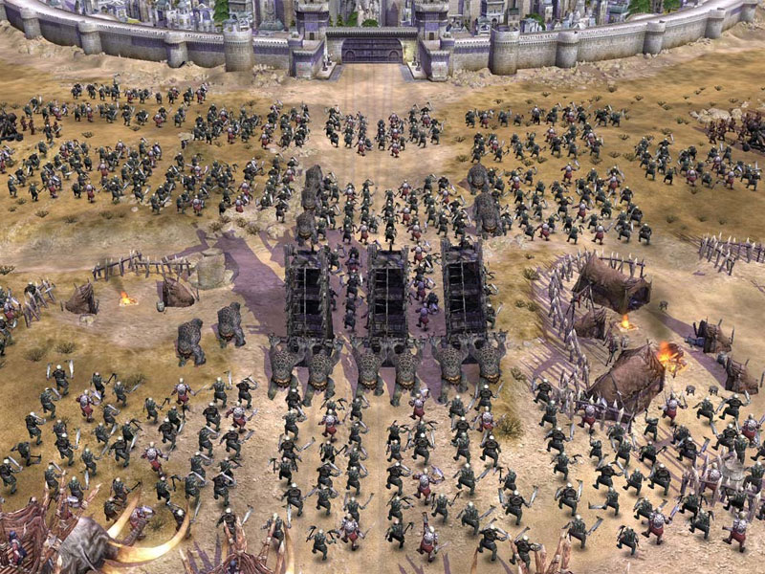
AI Programming Concepts
The Mordor orcs units are divided into groups of 12.
Gondor fighters are divided into units of 5.
Units use heuristic to move towards the enemy. When they are close, they start attacking others using weapons
Large groups of orcs use heuristics to move into position for melee combat in the Lord of the Rings: The Battle for Middle-Earth

Slide 63
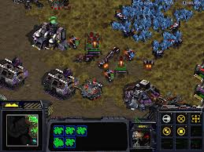
AI Programming Concepts
Real path find could take 1 or 2 seconds for path finding (at the first time when released – limited CPU performance.
StarCraft units use a heuristic to aid in movement

Slide 64
AI Programming Concepts
Data-driven design
Tuning and polishing behaviour based on data
One way is using parameters such as aggressiveness or energy level
XML is a common format these days
No need to recompile the program or get help from software engineers to change a behaviour

Slide 65
AI Programming Concepts
Object-oriented design
A powerful technique used in modern video games
A combination of code and data
Use of inheritance to extend functionality while keeping common features
Base class: game object
Derived classes: rocket and missile
Use of aggregation to mix features in a modular way
Tank object including Armor, Gun, and Movement modules

Slide 66
AI Programming Concepts
Control methods
Time-based
Called every few milliseconds
Easy to implement
May cause extra waiting time
Event-based
Called when some event happens
More complicated
Can provide rapid response

Slide 67
Components of Game Search
A game can be defined as a kind of search problem with the following components :
The initial state: board position, indication of whose move it is
A set of operators: define the legal moves that a player can make
A terminal test: determines when the game is over (terminal states)
A utility (payoff) function: gives a numeric value for the outcome of a game (-1,+1,0) ?

Slide 68
Game Trees
Trees are used to represent Problem spaces
Root node represents the “board” configuration at which a decision must be made as to what is the best single move to make next
Evaluation function rates a board position
Arcs represent the possible legal moves for a player (no costs associated)

Slide 69
Game Trees
Terminal nodes
represent end-game configurations
the result must be one of “win”, “lose”, and “draw”, possibly with numerical payoff
Complete game tree
all configurations that can be generated from the root by legal moves (all leaves are terminal nodes)
Incomplete game tree
all configurations that can be generated from the root by legal moves to a given depth (looking ahead to a given number of steps)

Slide 70
Why Incomplete Game Tree?
Usually not possible to expand a game to end-game status
have to choose a ply-depth that is achievable with reasonable time and resources
absolute ‘win-lose’ values become heuristic scores
heuristics are devised according to knowledge of the game

Slide 71
Evaluation Function
Evaluation function or static evaluator is used to evaluate the "goodness" of a game position.
The zero-sum assumption allows the use of a single evaluation function to describe the goodness of a board with respect to both players.
f(n) > 0: position n good for me and bad for you
f(n) < 0: position n bad for me and good for you
f(n) near 0: position n is a neutral position.
f(n) >> 0: win for me.
f(n) << 0: win for you..

Slide 72
Evaluation Functions
Evaluation function is a heuristic function, and it is where the domain experts’ knowledge resides.
Most evaluation functions are specified as a weighted sum of position features:
f(n) = w1*feat1(n) + w2*feat2(n) + ……+ wk*featk(n)

Slide 73
Evaluation Functions
Possible heuristic for Chess
h = A * total piece value captured + B * some evaluation of king position + C* freedom of movement in attack + D* some other function… etc…
Other possible features are piece count, piece placement, squares controlled
Deep Blue has about 6,000 features in its evaluation function

Slide 74
Minimax - Overview
Minimax the heart of almost every computer board game
Applies to games where:
Players take turns
We have perfect information
Chess and Checkers
But can also work for games without perfect information or chance
Poker, Monopoly, and Dice
Can work in real-time (i.e. not turn based) with timer (iterative deepening search)

Slide 75
Minimax - Overview
John von Neumann outlined a search method (Minimax ) that maximize your position whilst minimizing your opponent’s (In 1944)
Minimax searches state space using the following assumptions
your opponent is ‘as clever’ as you
if your opponent can make things worse for you, they will take that move
your opponent won’t make mistake

Slide 76
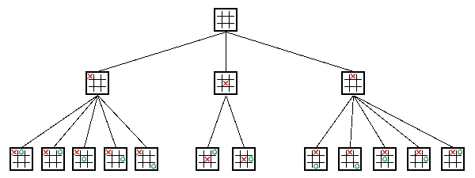
Minimax - Overview
Players called Min and Max (next)
Unlike binary trees can have any number of children
Depends on the game situation
Levels usually called plies (a ply is one level)
Each ply is where "turn" switches to other player

Slide 77
Minimax Procedure
Start a MAX (MIN) node with current board configuration
Expand nodes down to some depth of look-ahead in the game
apply the evaluation function at each of the leaf nodes
“Back up” values for each of the non-leaf nodes until a value is computed for the root node
at MIN nodes, the backed-up value is the minimum of the values associated with its children
at MAX nodes, the backed-up value is the maximum of the values associated with its children
Pick the operator associated with the child node whose backed-up value determined the value at the root

Slide 78
Minimax - Concept
MAX
1
A
MIN
1
B
-3
C
MAX
4
D
1
E
2
F
-3
G
4
-5
-5
1
-7
2
-3
-8
= terminal position
= agent
= opponent

Slide 79
Minimax - Nim
Start with a pile of tokens, e.g. 7
At each move the player must divide the tokens into two non-empty, non-equal piles
+
+
+

Slide 80
Nim’s Search Tree
7
6-1
5-2
4-3
5-1-1
4-2-1
3-2-2
3-3-1
4-1-1-1
3-2-1-1
2-2-2-1
3-1-1-1-1
2-2-1-1-1
2-1-1-1-1-1

Slide 81
Minimax - Nim
Draw the complete search tree
Assuming MIN plays first, complete the MIN/MAX tree
Assume that a utility function of
0 = a win for MIN
1 = a win for MAX

Slide 82
1
7
MIN
1
1
1
MAX
6-1
5-2
4-3
0
1
0
1
MIN
5-1-1
4-2-1
3-2-2
3-3-1
1
0
0
MAX
4-1-1-1
3-2-1-1
2-2-2-1
MIN
0
1
3-1-1-1-1
2-2-1-1-1
MAX
0
2-1-1-1-1-1

Slide 83
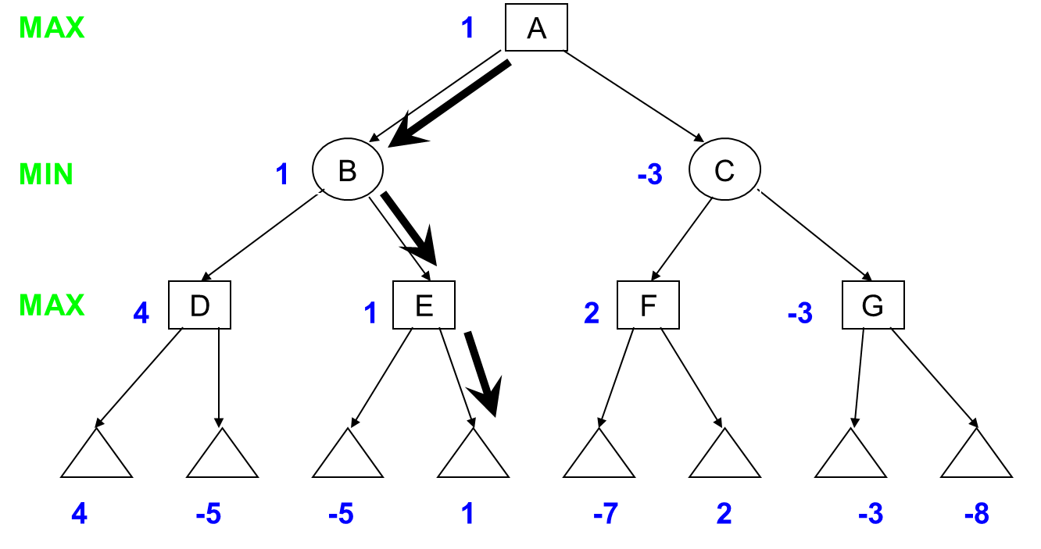
Game Playing
If both players play their best moves, then which “line” does the play follow?

Slide 84
Key points
Game tree
describes the possible sequences of play
might be drawn as a graph if we merge together identical states
Minimax
Utility values assigned to the leaves
Values “backed up” the tree by
MAX node takes max value of children
MIN node takes min value of children
Can read off best lines of play and results
Depth Bound – utility of terminal states estimated using an “evaluation function”

Slide 85
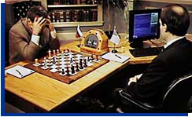
Chess
Garry Kasparov and Deep Blue. © 1997, GM Gabriel Schwartzman's Chess Camera, courtesy IBM.

Slide 86
Minimax and Chess
With full tree, can determine best possible move
The full tree impossible for some games!
Chess
Chess has ~ 35 legal moves at a given time
Exponential growth:
35 at one ply
35² = 1225 at two plies
35⁶ = 2 billion and
35¹⁰ = 2 quadrillion
Games can last 40 moves (or more)
35⁴⁰ or 10¹²⁰
Stars in universe: ~ 2²⁸
10¹²⁰ > The number of atoms in the universe

Slide 87
Chess
200 million positions/second = 10¹⁰⁰ years to evaluate all possible games
Age of universe = 10¹⁰
Searching to depth = 40, at one game per microsecond it would take 10⁹⁰ years to make its first move

Slide 88
Minimax and Chess
For large games (Chess) can’t see end of the game. Must estimate winning or losing from top portion
Evaluate() function to guess the end for a given board
A numeric value, much smaller than victory
Example: Checkmate for Max will be one million, for Min minus one million
So, computer’s strength at chess comes from:
How deep can search
How well can evaluate a board position
(In some sense, like a human – a chess grand master can evaluate board better and can look further ahead)

Slide 89
Minimax– Alpha-Beta Pruning
Minimax searches entire tree, even if in some cases the rest can be ignored
In general, stop evaluating move when find worse than previously examined move
Does not benefit the player to play that move, it need not be evaluated any further.
Save processing time without affecting final result

Slide 90
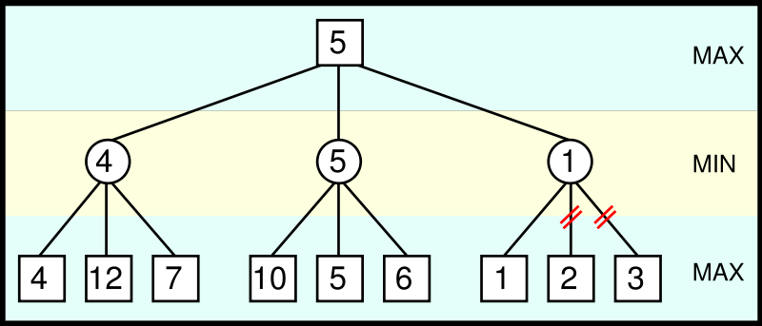
Minimax– Alpha-Beta Pruning Example
From Max point of view, 1 is already lower than 4 or 5, so no need to evaluate 2 and 3 (bottom right) → Prune

Slide 91
Minimax– Alpha-Beta Pruning Idea
Two scores passed around in search
Alpha – best score by some means
Anything less than this is no use (can be pruned) since we can already get alpha
Minimum score Max will get
Initially, negative infinity
Beta – worst-case scenario for opponent
Anything higher than this won’t be used by opponent
Maximum score Min will get
Initially, infinity
Recursion progresses, the "window" of Alpha-Beta becomes smaller
Beta < Alpha → current position not result of best play and can be pruned

Slide 92
Alpha-Beta Pruning
We can improve on the performance of the Minimax algorithm through alpha-beta pruning.
Basic idea: “If you have an idea that is surely bad, don't take the time to see how truly awful it is.” -- Pat Winston
MAX
>=2
We don’t need to compute the value at this node.
No matter what it is it can’t affect the value of the root node
MIN
=2
<=1
MAX
2
7
1
?

Slide 93
Alpha-Beta Pruning
Traverse the search tree in depth-first order
At each MAX node n
alpha(n) = maximum value found so far
At each MIN node n
beta(n) = minimum value found so far
Note: The alpha values start at -infinity and only increase, while beta values start at +infinity and only decrease.

Slide 94
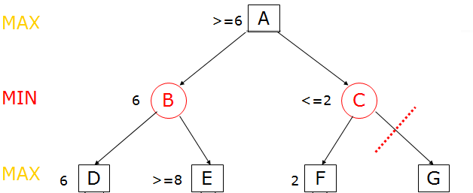
Alpha-Beta Pruning
Alpha cutoff:
Stop searching below MIN node n
if beta(n) <= alpha(i) for some MAX node ancestor i of n.

Slide 95
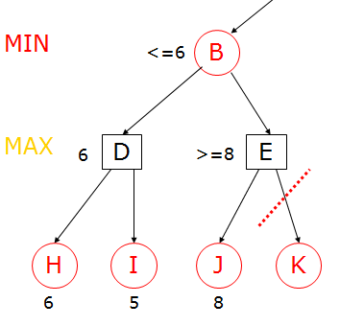
Alpha-Beta Pruning
Beta cutoff:
Given a MAX node n, cut off the search below n
if alpha(n) >= beta(i) for some MIN node ancestor i of n.

Slide 96
MAX
A
MIN
B
C
<=6
MAX
D
E
6
>=8
H
I
J
K
6
5
8
= agent
= opponent

Slide 97
MAX
>=6
A
MIN
B
C
6
<=2
MAX
D
E
F
G
6
>=8
2
H
I
J
K
L
M
6
5
8
2
1
= agent
= opponent

Slide 98
MAX
>=6
A
MIN
B
C
6
2
MAX
D
E
F
G
6
>=8
2
H
I
J
K
L
M
6
5
8
2
1
= agent
= opponent

Slide 99
Alpha-beta Pruning
MAX
6
A
MIN
B
C
6
2
alpha cutoff
MAX
D
E
F
G
6
>=8
beta cutoff
2
H
I
J
K
L
M
6
5
8
2
1
= agent
= opponent

Slide 100
References
Game Artificial Intelligence
John B. Ahlquist and Jeannie Novak
Thomson, 2008
AI Game Engine Programming
Brian Schwab
Charles River Media, 2004
Some slides are taken from the different online sources. I acknowledge them.

Slide 101
Refeences
Level Up!: The Guide to Great Video Game Design
Scott Rogers
Wiley, 2010
Level Design for Games
Phil Co
New Raiders, 2006

Slide 102
Thank you!

